Slide 1

ACTIVE SERVER PAGE

Slide 2
ASP Dot Net
Active Server Page is used to create web applications.
ASP.NET applications are compiled codes, written using the extensible and reusable components or objects present in .NET framework.
Web application means client-server application.

Slide 3
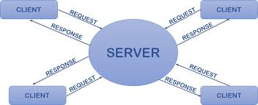
Client Server Application

Slide 4
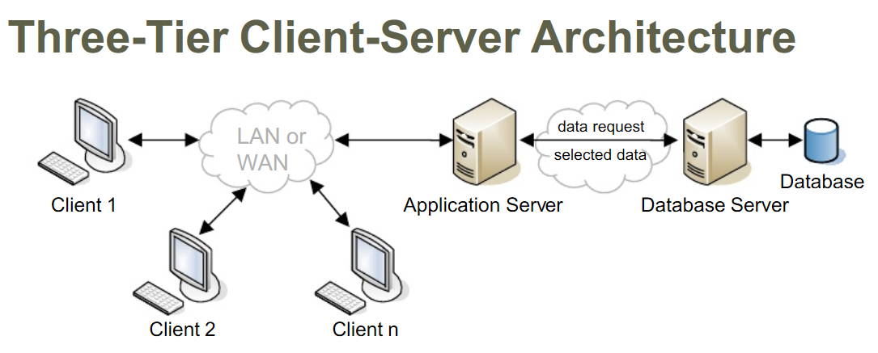

Slide 5
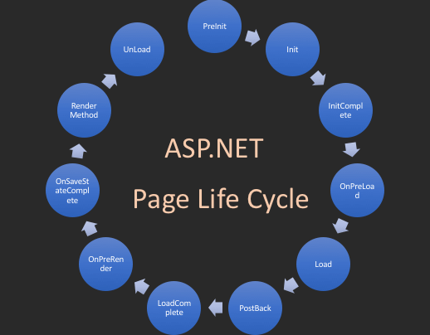

Slide 6
ASP Dot Net
PreInit - PreInit is the first event in page life cycle. It checks the IsPostBack property and determines whether the page is a postback. It sets the themes and master pages, creates dynamic controls, and gets and sets profile property values.

Slide 7
ASP Dot Net
Init - Init event initializes the control property and the control tree is built. InitComplete - InitComplete event allows tracking of view state. All the controls turn on view-state tracking.
PreLoad - PreLoad occurs before the post back data is loaded in the controls.
Load -The Load event is raised for the page first. The controls in the control tree are created.

Slide 8
ASP Dot Net
PostBack is the name given to the process of submitting all the information that the user is currently working on and send it all back to the server.
LoadComplete - The loading process is completed, control event handlers are run, and page validation takes place. PreRender - The PreRender event occurs just before the output is rendered. By handling this event, pages and controls can perform any updates before the output is rendered.

Slide 9
ASP Dot Net
SaveStateComplete - State of control on the page is saved. Personalization, control state and view state information is saved. The HTML markup is generated.
UnLoad - The UnLoad phase is the last phase of the page life cycle. It raises the UnLoad event for all controls recursively and lastly for the page itself. Final cleanup is done and all resources and references, such as database connections, are freed.

Slide 10
ASP Dot Net
ASP contains mainly two concepts.
Controls.
Objects.

Slide 11
Controls of ASP Dot Net
There are six type controls.
HTML
Server
Data
Validation
Ajax
Navigation

Slide 12
Objects[State Managements] of ASP Dot Net
There are six type objects.
Request
Response
Server
Application
Session
Cookies

Slide 13
HTML and SERVER Controls
Hypertext Markup Language (HTML) is the standard markup language for creating web pages and web applications. It runs on client side only.
Server Controls are runs both client and server side.

Slide 14
Code Behind and Inline coding
Code Behind refers to the code for an ASP.NET Web page that is written in a separate class file that can have the extension of .aspx.cs .
Inline Code refers to the code that is written inside an ASP.NET Web Page that has an extension of .aspx.

